Slide 1
LLM Post-Training
Plaban Kumar Bhowmick
Department of AI
plaban@ai.iitkgp.ac.in

Slide 2
LLM Training Stages
Pre-training
Fine-Tuning
Alignment
Post-Training
Tie et al., A survey on post-training of large language models, 2025

Slide 3
Post-Training Language Models (PoLMs)
Fine-Tuning
Adjusts model parameters using labeled datasets or specific task data
Alignment
Optimizes models to better align with user preferences
Knowledge Adaptation
Enables models to incorporate domain-specific knowledge
Reasoning
Ability to make logical inferences and decision

Slide 4
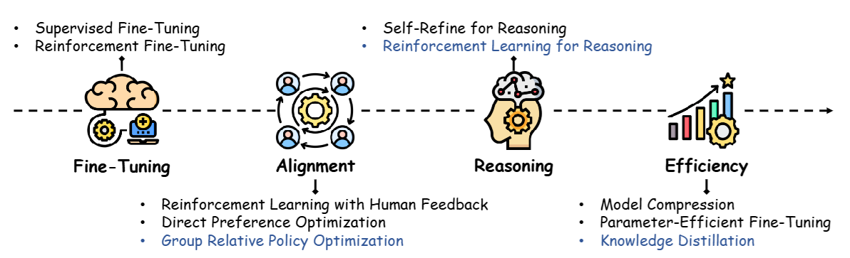
Evolution of PoLMs

Slide 5
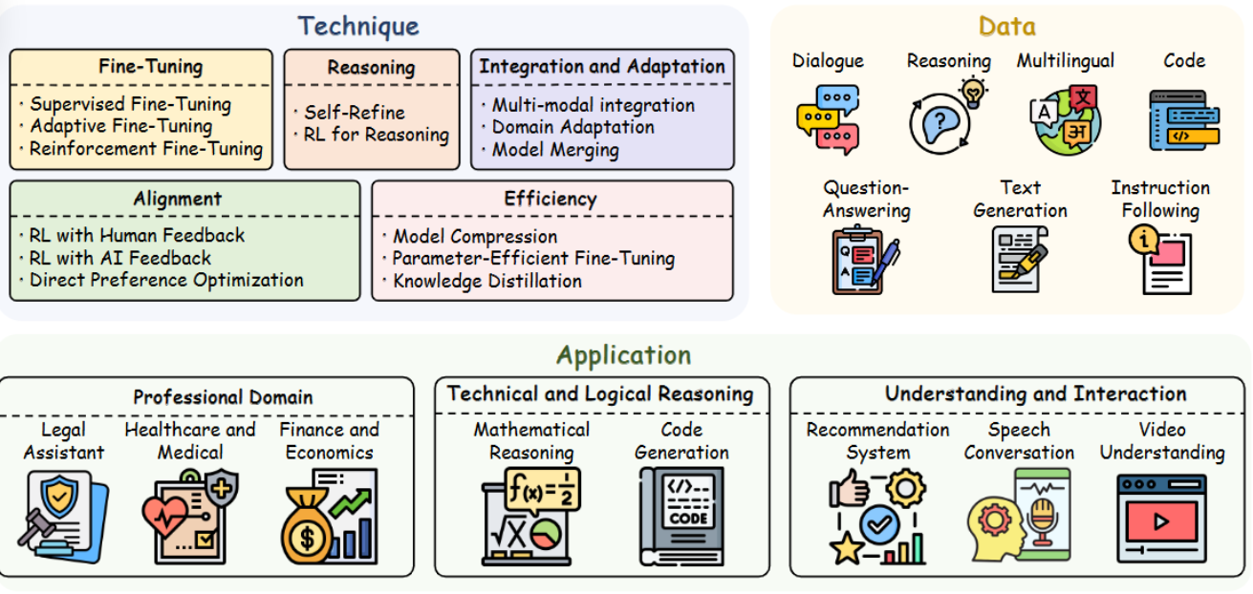
PoLM Scope

Slide 6
Fine Tuning PoLMs
Supervised Fine-Tuning
Adaptive Fine-Tuning
Instruction Tuning
Prompt Tuning
Reinforcement Fine-Tuning

Slide 7
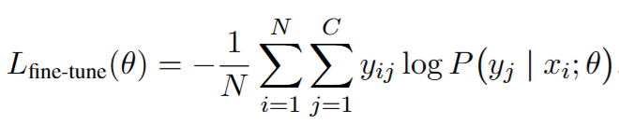
Supervised Fine-Tuning (SFT)
Require task specific annotated dataset
Directly adjusts model parameters using annotated data

Slide 8
Instruction Tuning
Pre-Trained language model
Fine tune on tasks B,C,D,….
Inference on task A
How to create dataset of instruction fine tuning?
Transforming existing NLP training datasets using prompt templates
Collecting human generated prompts and generate answers manually
Collecting human-generated prompts and generating answers using existing LLM

Slide 9
Instruction Tuning
Generating datasets from existing NLP benchmarks
"sentence": "A stirring, funny and finally transporting re-imagining of Beauty and the Beast.", "label": 1
"sentence": "A visually flashy but narratively opaque and emotionally vapid exercise.", "label": 0
"instruction": "Classify the sentiment of the given sentence as Positive or Negative.",
"input": "A stirring, funny and finally transporting re-imagining of Beauty and the Beast.",
"output": "Positive"
"instruction": "Decide whether the sentiment expressed in the text is positive or negative.",
"input": "A visually flashy but narratively opaque and emotionally vapid exercise.",
"output": "Negative"
"instruction": "Is the movie review written with a positive or a negative tone?",
"input": "The film drags on with no sense of direction or purpose.",
"output": "Negative"

Slide 10
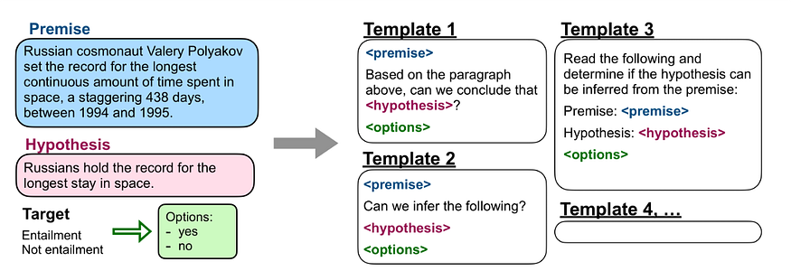
Instruction Tuning Datasets
FLAN / FLAN-T5

Slide 11
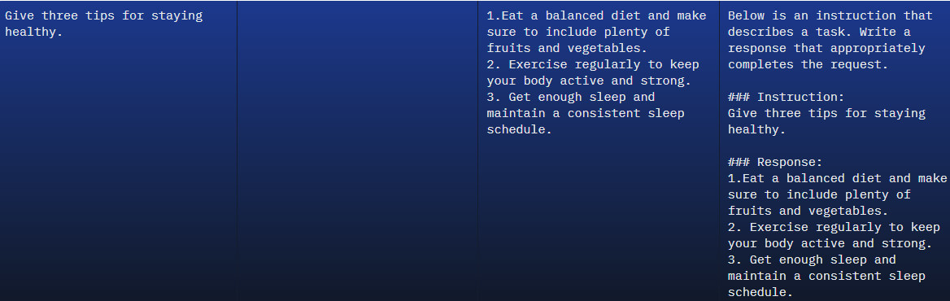
Instruction Tuning Datasets
Alpaca (Stanford): response pairs generated by prompting GPT-3

Slide 12
Parameter Efficient Fine-Tuning (PEFT)
Additive PEFT
introduces additional trainable components or parameters into the pre-existing model
Reparameterized PEFT
Restructures the model’s parameters during the training phase
Reverts to the original form for inference
Selective PEFT
Optimizing a specific subset of the model’s parameters
Quantization PEFT
Quantization for efficiency
Multi-task PEFT
Enhancing multi-task learning capabilities

Slide 13
Adapter: General Setup
Adapter Task1
Adapter Task K
Adapter Task N
Adapter Task1
Adapter Task K
Adapter Task N
Task with task ID
Only Task
Explicit Task Identification
Adapter Fusion

Slide 14
Adapter: General Setup
Adapter Task1
Adapter Task K
Adapter Task N
Adapter Task1, Task2, …, Task N
Only Task
Only Task
Adapter Routing
Multi-Task Adapter

Slide 15
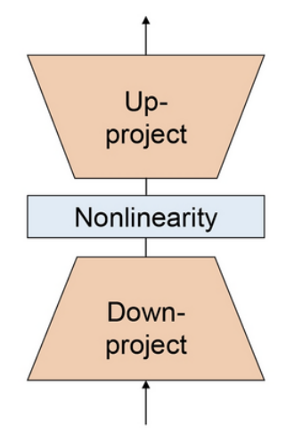
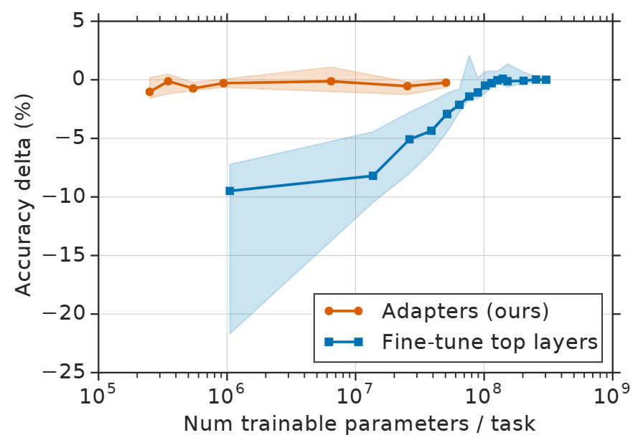
Additive PEFT: Adapter
A general form of Adapter

Slide 16
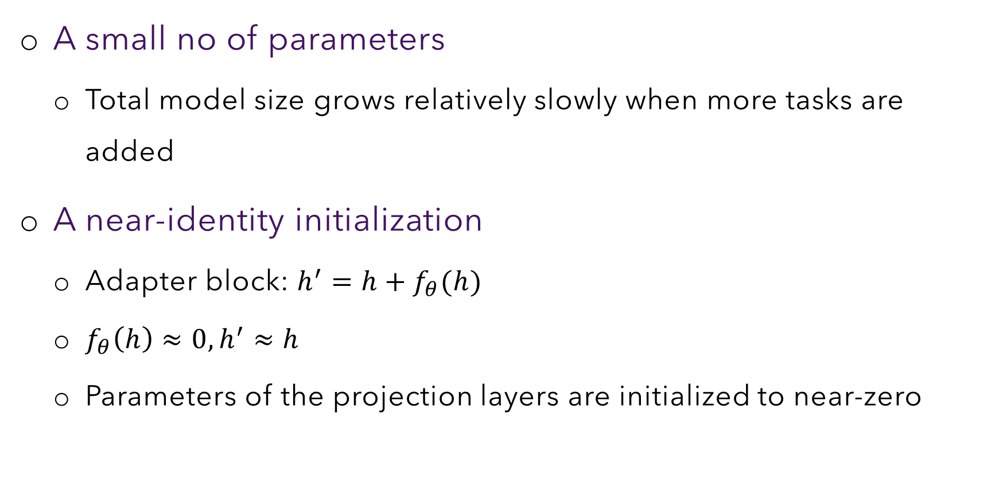
Two Requirements of Adapters
A small no of parameters
Total model size grows relatively slowly when more tasks are added
A near-identity initialization
Adapter block: $h^{′}=h+f_{θ}(h)$
$f_{θ}\left(h\right)≈0, h^{′}≈h$
Parameters of the projection layers are initialized to near-zero

Slide 17
Additive PEFT

Slide 18
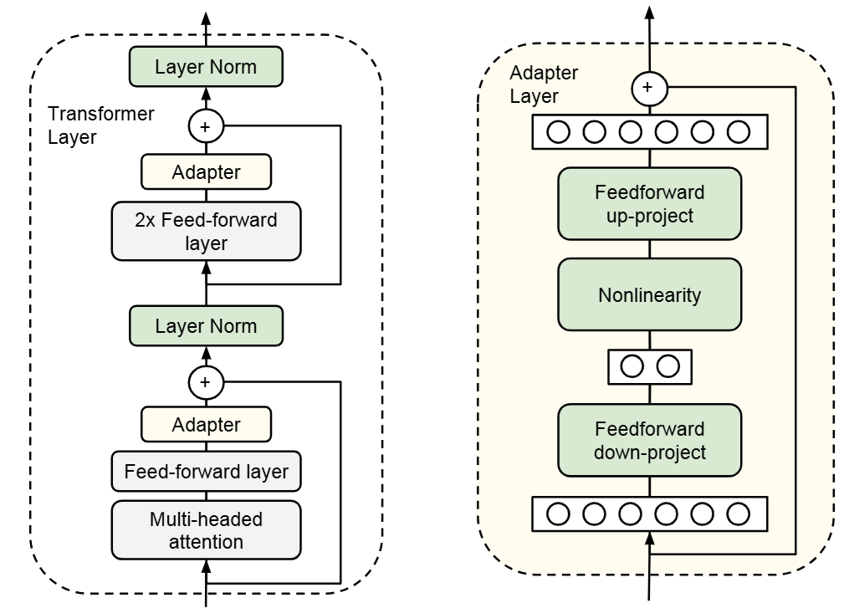

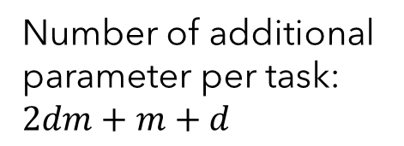


Sequential Adapters
$$d$$
Number of additional parameter per task: $2dm+m+d$
$$m$$
$$d$$
Sequential Adapter

Slide 19
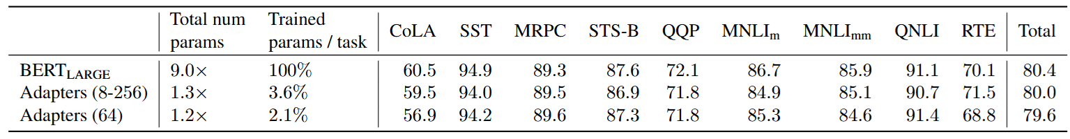
Sequential Adapters

Slide 20
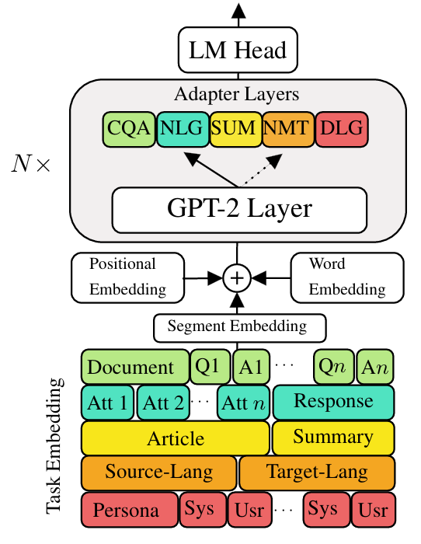

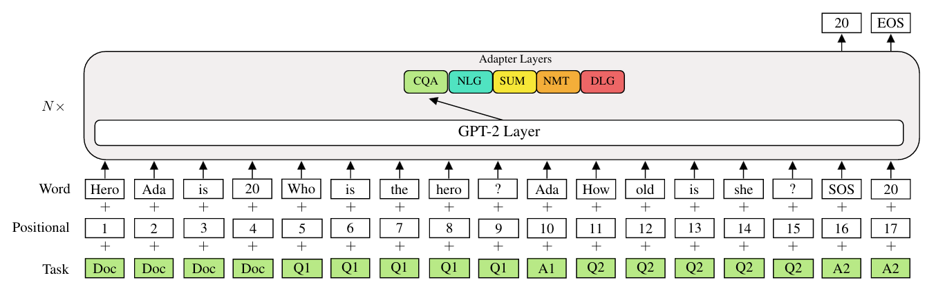
Residual Adapter
Actual task specific tokens used for QA to form task/segment embeddings –
"qa": ["<bos_qa>", "<eos_qa>", "<question>", "<answer>", "<document>"]

Slide 21
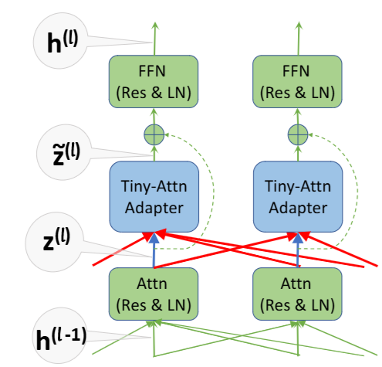
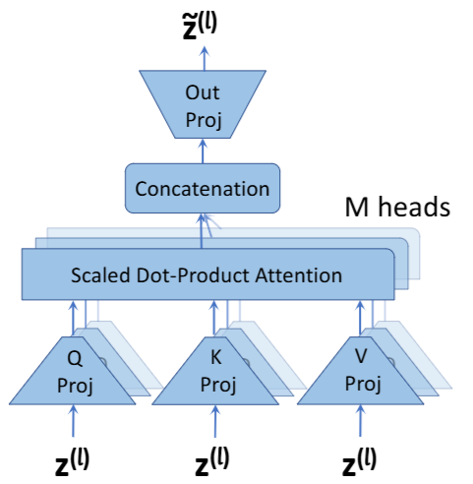
Tiny-Attention Adapter
Adding context in the embedding computation in adapter

Slide 22
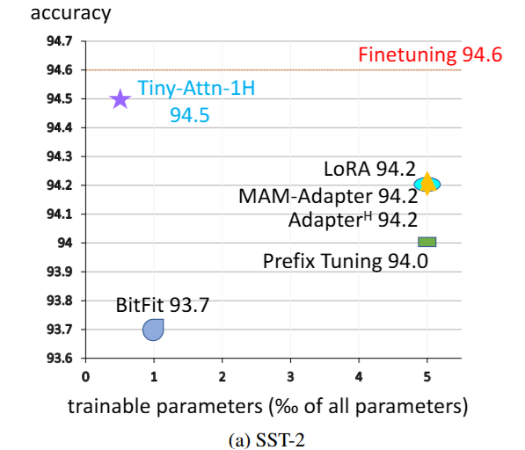
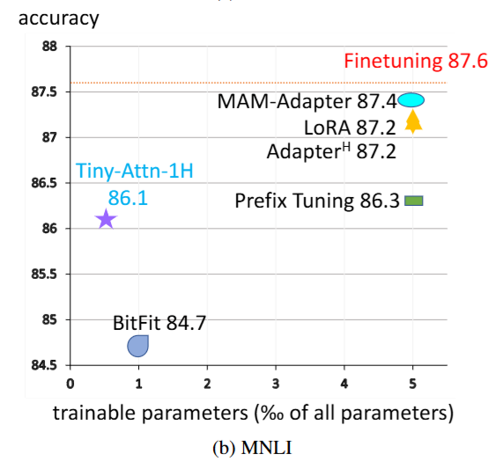
Tiny-Attention Adapter

Slide 23
Soft Prompt

Slide 24
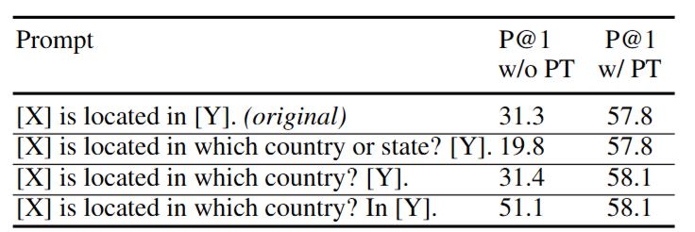
Soft Prompt as Continuous Prompt
Discrete Prompt: Sequence of real token embeddings
Continuous Prompt: Sequence of virtual (trainable) token embeddings
Why do we need continuous prefix tuning?
Manual prompt: Performance greatly varies with small changes

Slide 25
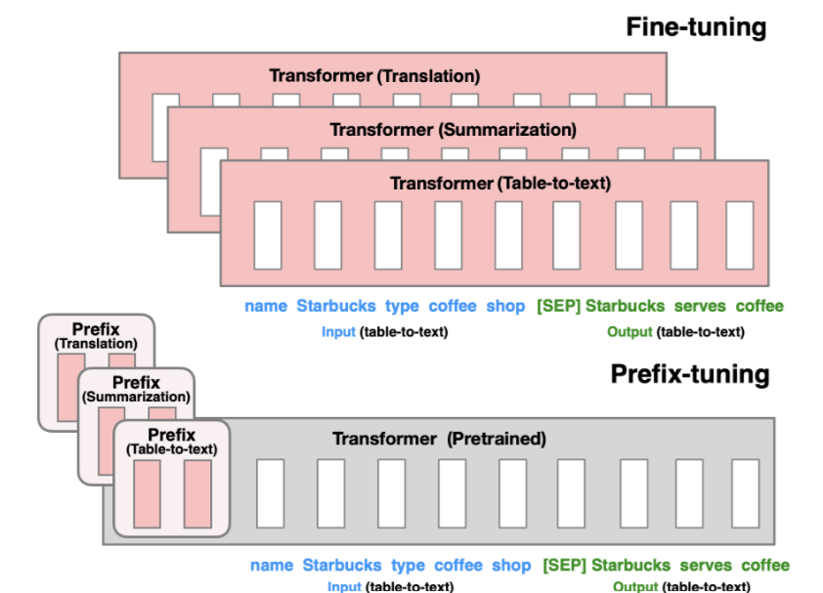
Soft-Prompt: Prefix-Tuning or Prompt Tuning

Slide 26
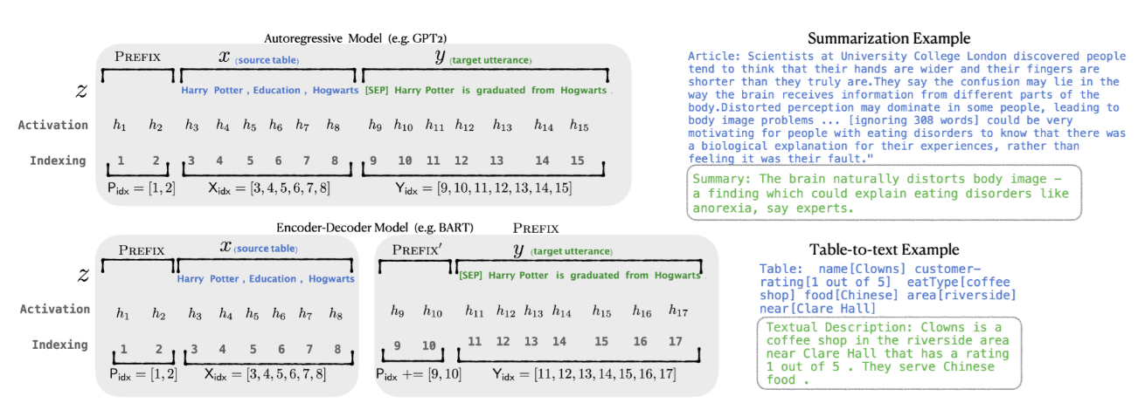
Soft-Prompt: Prefix-Tuning or Prompt Tuning

Slide 27

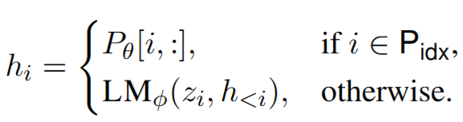






Soft-Prompt: Prefix-Tuning or Prompt Tuning
$$h_{i}∈ℝ^{d}$$
$$h_{i}∈ℝ^{d}$$
$$θ$$
$$P_{θ}^{′}[i,:]$$
$$h_{i}∈ℝ^{k}$$
$$h_{i}∈ℝ^{d}$$

Slide 28
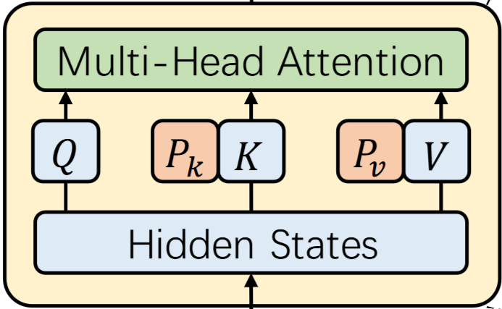
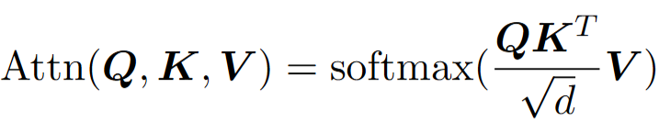
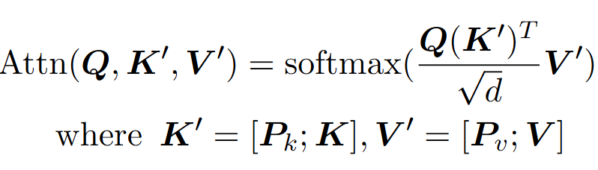


Soft-Prompt: Prefix-Tuning or Prompt Tuning
$;$denotes concatenation
$P_{k}, P_{v}$→ Prefix Key and Value representation

Slide 29
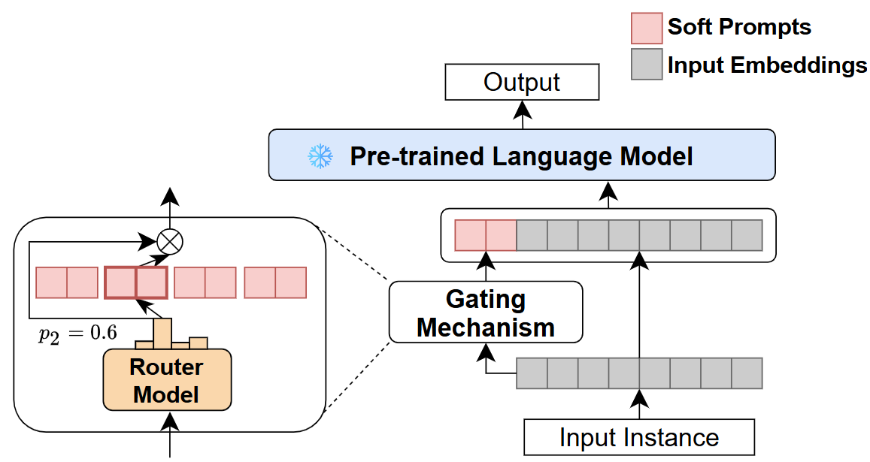
Sparse Mixture of Prompts (SMoP)

Slide 30
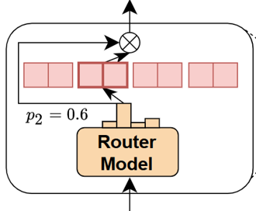








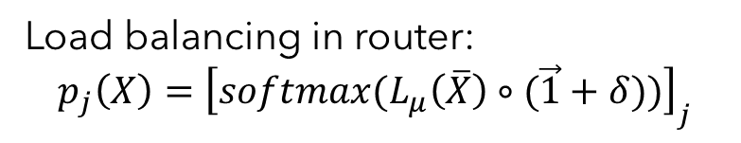

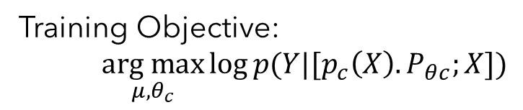

Sparse Mixture of Prompts
Router Model: $L_{μ}=f\left(μ\right), μ∈ℝ^{e×k}$
$k$→ No of soft prompt units
$$l$$
$P_{θ_{1}},P_{θ_{2}},…,P_{θ_{k}}$→ soft prompt embeddings of $k$ units
$$k$$
$\overline{X}$→ average of input $X$
$$p_{j}\left(X\right)$$
Routing probability: $p_{j}\left(X\right)={\left[softmax(L_{μ}(\overline{X}))\right]}_{j}$
$$L_{μ}=f\left(μ\right)$$
$$j=1,2, …,k$$
Training Objective:
$\underset{μ, θ_{c}}{arg max}{\log{p(Y|[p_{c}\left(X\right).P_{θc};X])}}$
$$\overline{X}$$
Load balancing in router:
$$p_{j}\left(X\right)={\left[softmax(L_{μ}\left(\overline{X}\right)∘(\vec{1}+δ))\right]}_{j}$$
$$δ\sim 𝒩(0,1)$$

Slide 31
Soft Prompt: Adaptive Prefix Tuning (APT)
Length of prefix tokens (or the number of trainable parameters) is usually the same at each layer.
Bottom layers of the language model tend to capture concrete and shallow phrase-level features
More information: Greater prefix length
Top layers concerns more with abstract semantic information
Average information: Shorter prefix length

Slide 32
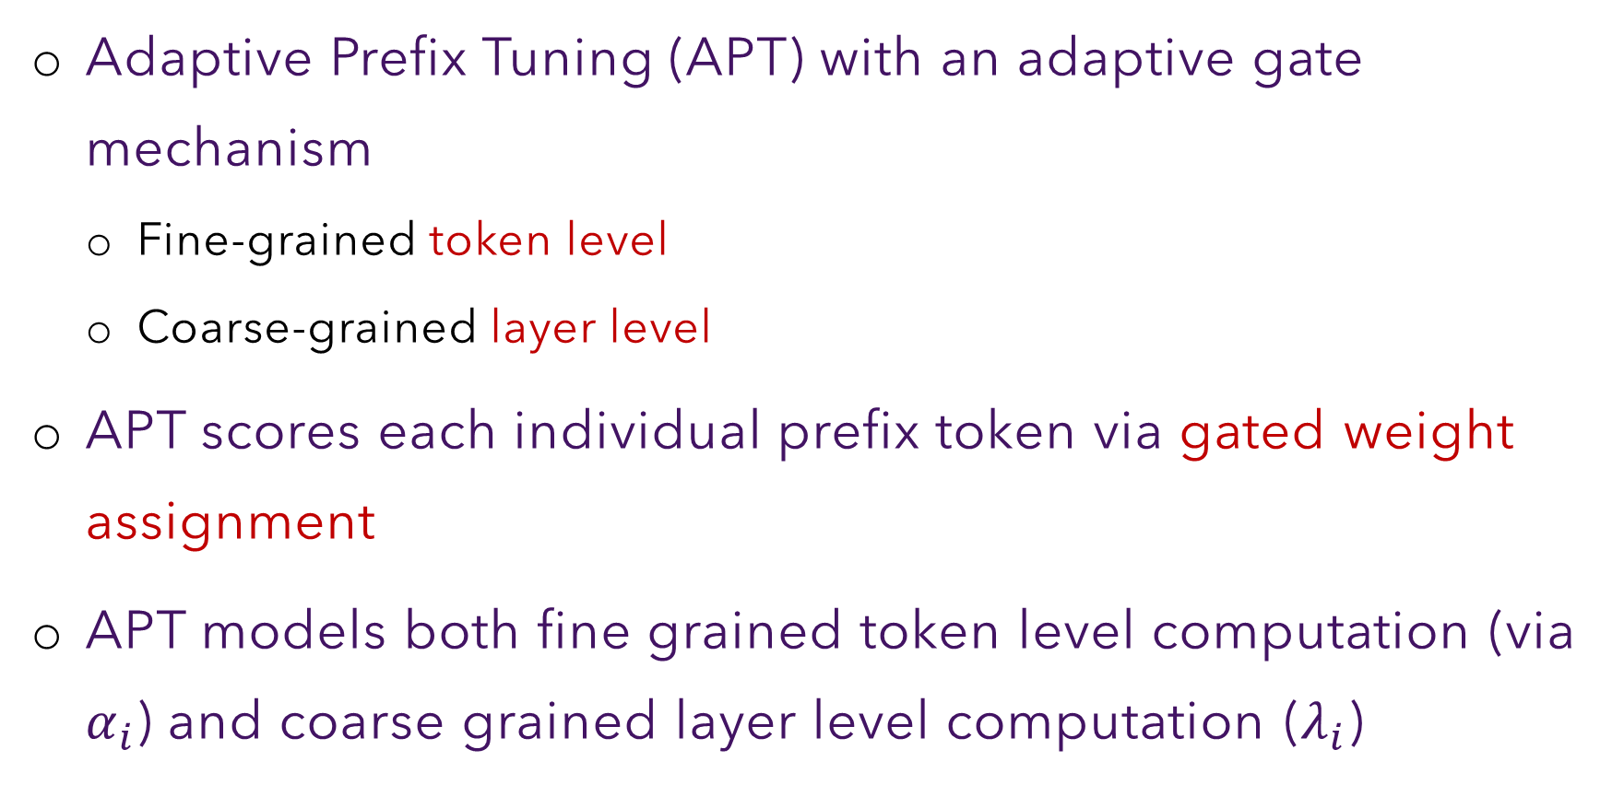
Soft Prompt: Adaptive Prefix Tuning (APT)
Adaptive Prefix Tuning (APT) with an adaptive gate mechanism
Fine-grained token level
Coarse-grained layer level
APT scores each individual prefix token via gated weight assignment
APT models both fine grained token level computation (via $α_{i}$) and coarse grained layer level computation ($λ_{i}$)

Slide 33
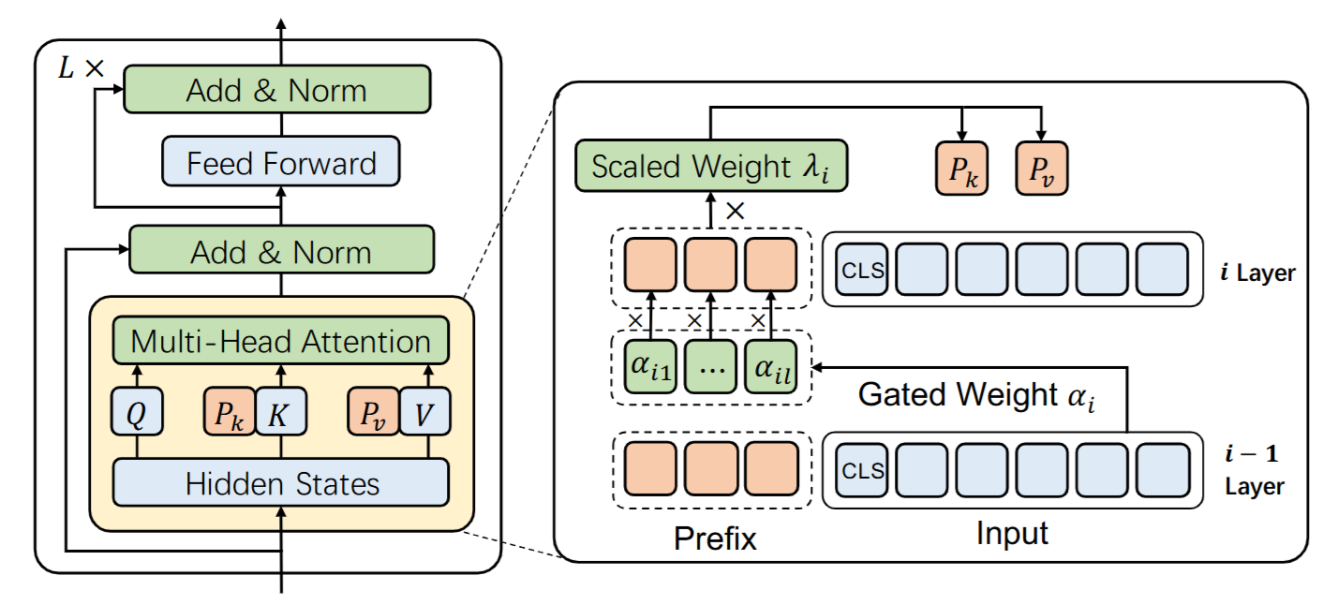

Soft Prompt: Adaptive Prefix Tuning (APT)
Dynamic prefix prompt length in layers

Slide 34
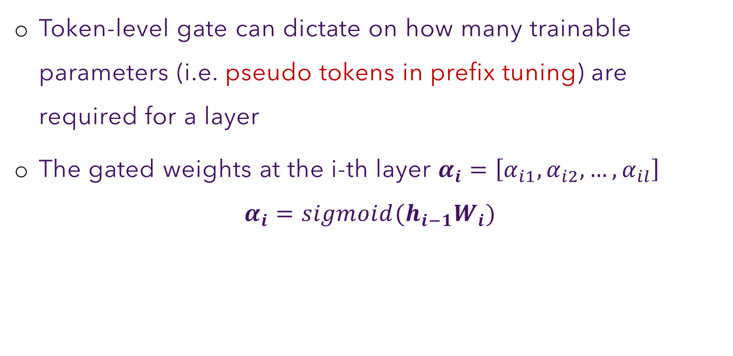
APT: Fine-Grained Weighting
Token-level gate can dictate on how many trainable parameters (i.e. pseudo tokens in prefix tuning) are required for a layer
The gated weights at the i-th layer $α_{i}=\left[α_{i1}, α_{i2},…, α_{il}\right]$
$$α_{i}=sigmoid(h_{i−1}W_{i})$$

Slide 35
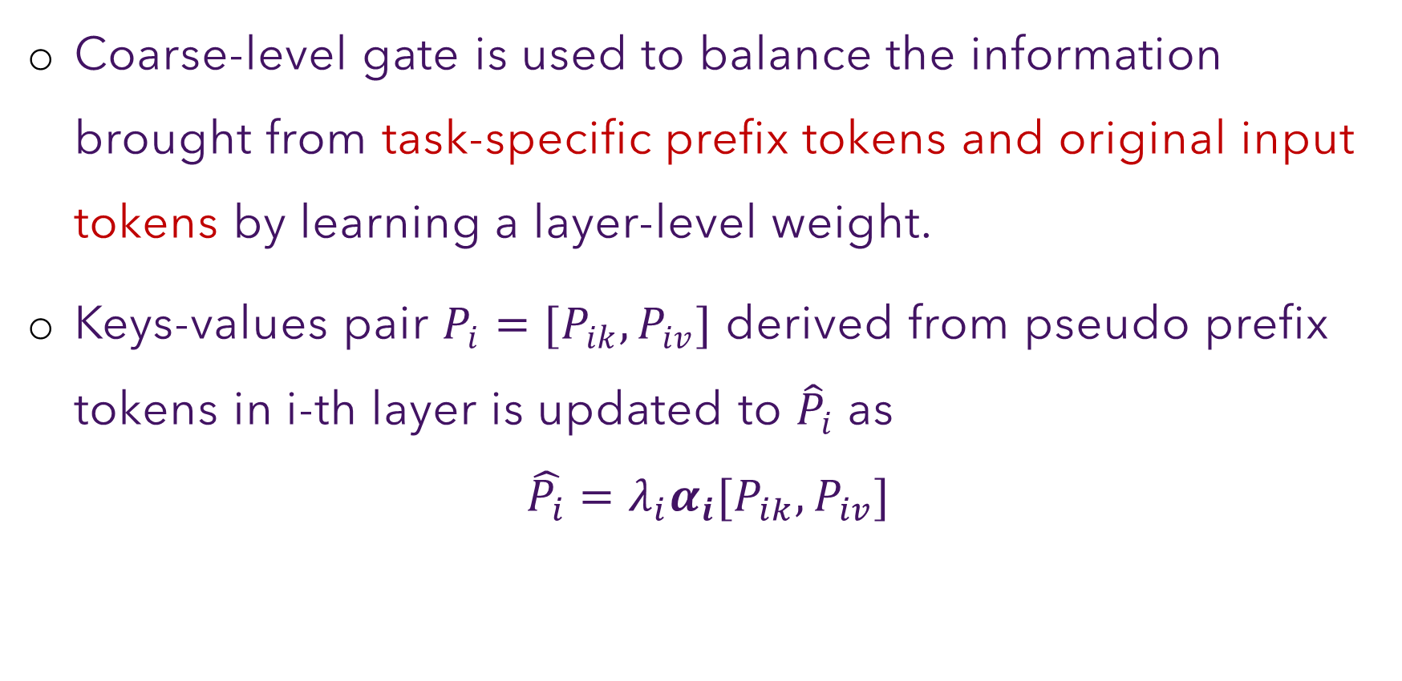
APT: Coarse-Grained Weighting
Coarse-level gate is used to balance the information brought from task-specific prefix tokens and original input tokens by learning a layer-level weight.
Keys-values pair $P_{i}=[P_{ik},P_{iv}]$ derived from pseudo prefix tokens in i-th layer is updated to ${\hat{P}}_{i}$ as
$$\hat{P_{i}}=λ_{i}α_{i}[P_{ik},P_{iv}]$$

Slide 36
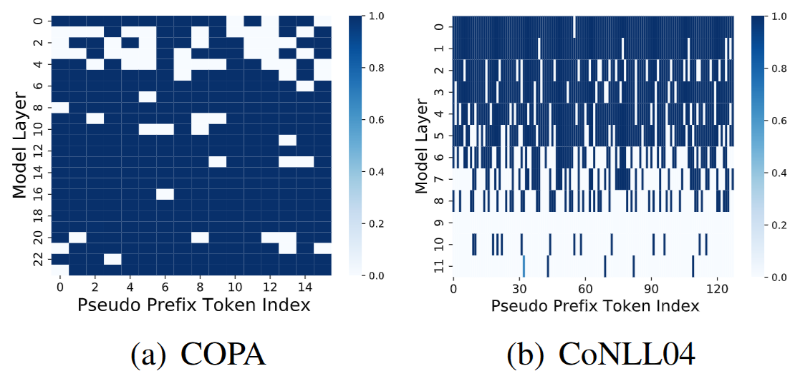
Prefix weight distribution learned by APT
CoNLL04 is concerned with bottom layers in the language model which are regarded as phrase-level features
COPA pays more attention to the higher layers, indicating semantic information

Slide 37
Instance-Dependent Prompt Generation (IDPG)
Soft-prompts leaned through prompt tuning are fixed for a given task
All inputs instances for a given task is prepended with the same soft prompt token embeddings
Does not align with the traditional LM objective
Unlikely to see many different sentences with the same prefix in the pre-training corpus
A unified prompt may disturb the prediction and lead to a performance drop
Can we generate input-dependent soft prompts?

Slide 38
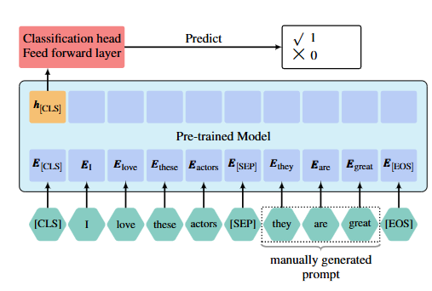
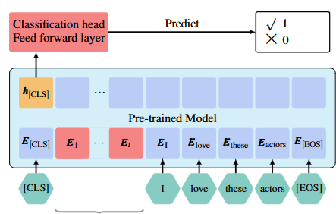
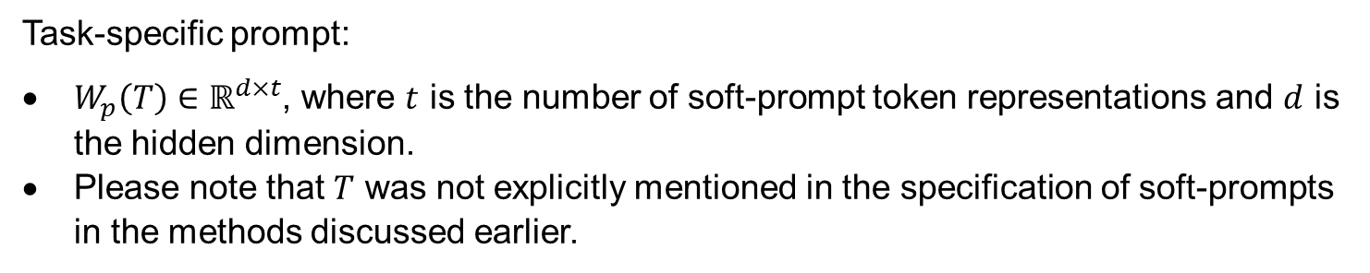
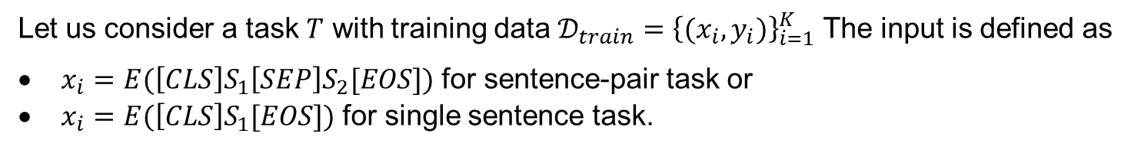
Prompt Tuning: General Framework
soft prompts
Let us consider a task $T$ with training data $𝒟_{train}={\left\{(x_{i},y_{i})\right\}}_{i=1}^{K}$ The input is defined as
$x_{i}=E(\left[CLS\right]S_{1}\left[SEP\right]S_{2}[EOS])$ for sentence-pair task or
$x_{i}=E(\left[CLS\right]S_{1}[EOS])$ for single sentence task.
Task-specific prompt:
$W_{p}\left(T\right)∈ℝ^{d×t}$, where $t$ is the number of soft-prompt token representations and $d$ is the hidden dimension.
Please note that $T$ was not explicitly mentioned in the specification of soft-prompts in the methods discussed earlier.

Slide 39
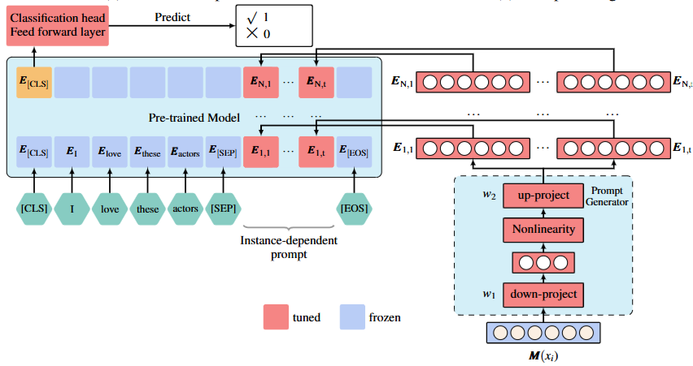
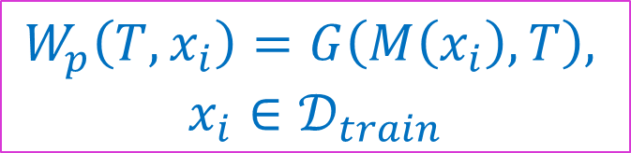
Instance-Dependent Prompt Generation (IDPG)
Time-stamped soft-prompts
Neural Prompt Generator
$$W_{p}\left(T,x_{i}\right)=G\left(M\left(x_{i}\right),T\right),$$
$$x_{i}∈𝒟_{train}$$
Encoding input with PTM

Slide 40
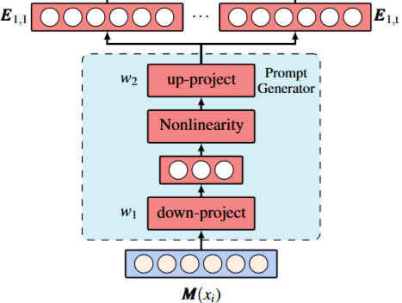
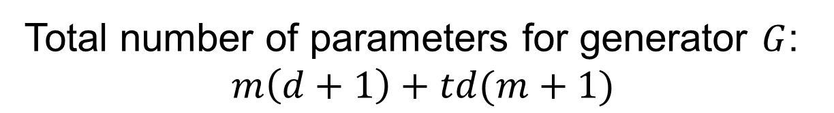
IDPG: Prompt Generator Module
Total number of parameters for generator $G$:
$$m\left(d+1\right)+td(m+1)$$

Slide 41
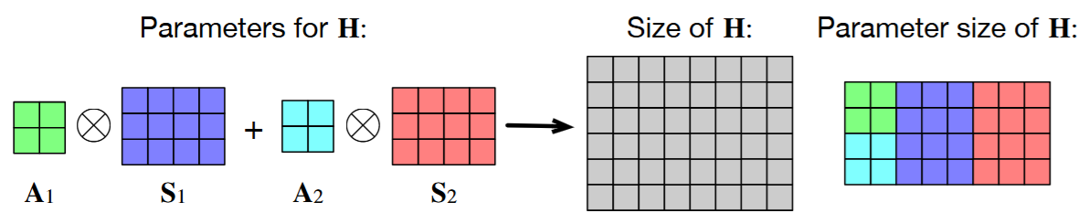
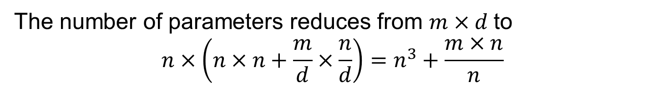

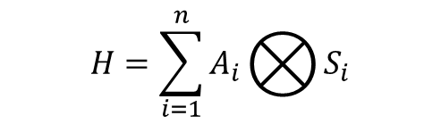
IDPG: Parameterized Hypercomplex Mult. (PMH)
When $m$ and $d$ are large, the cost of learning $W_{1}, W_{2}$ becomes the main bottleneck
PHM replaces the matrix $W_{i}$ (H in the Figure) by a sum of Kronecker products of several small matrices
$$H=\sum_{i=1}^{n}{A_{i}⨂{S_{i}}}$$
$$A_{i}∈ℝ^{n×n}, S_{i}∈ℝ^{\frac{m}{n}×\frac{d}{n}}$$
The number of parameters reduces from $m×d$to
$$n×\left(n×n+\frac{m}{d}×\frac{n}{d}\right)=n^{3}+\frac{m×n}{n}$$

Slide 42
Selective Prompt Tuning (SPT)
Soft-prompts are added to the input layer of a PTM
Late Prompt Tuning (LPT) suggested that prompt-tuning layers can be added in any intermediate layers of PTM
Selection of optimal PTM layer to insert the prompt-tuning layer varies with the PTM
Difficult to achieve manually
Selective Prompt Tuning (SPT) framework automatically searches for the optimal strategy of inserting prompts into the PTMs

Slide 43
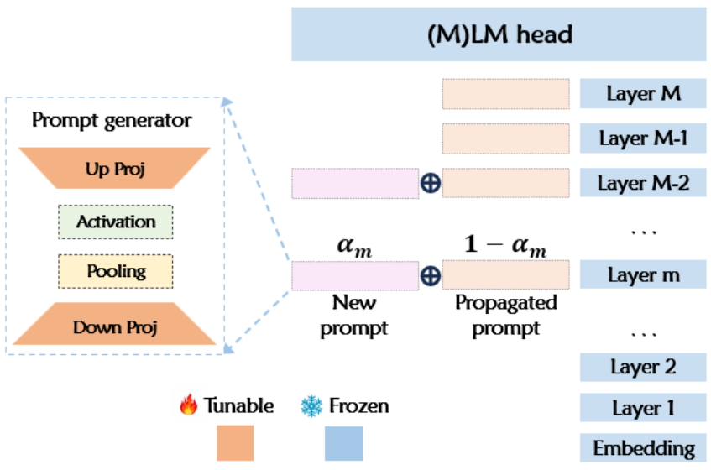
SPT Architecture

Slide 44
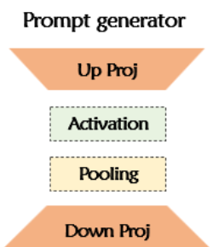
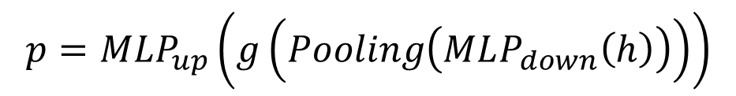
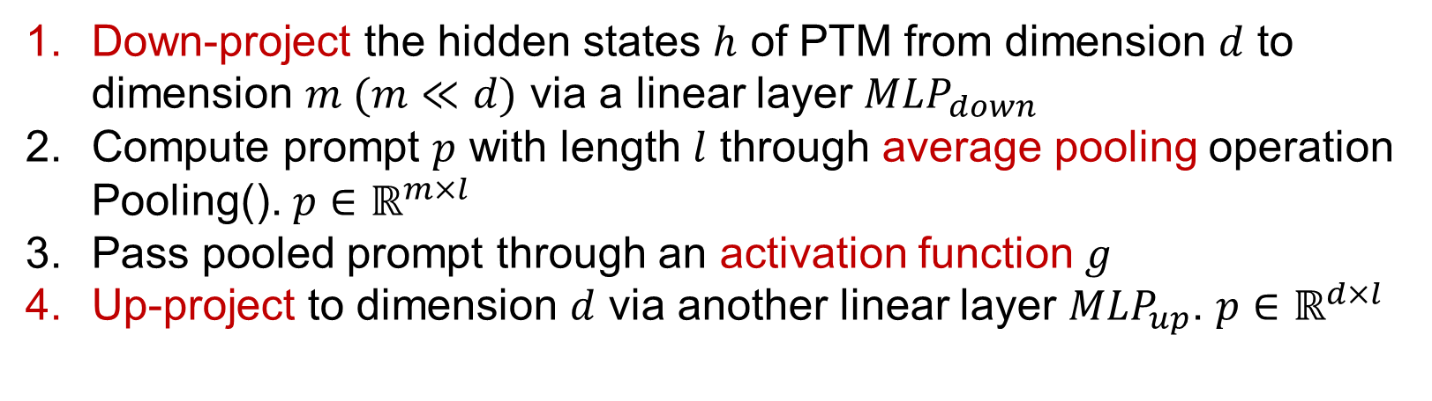
Prompt Generator
$$p=MLP_{up}\left(g\left(Pooling\left(MLP_{down}\left(h\right)\right)\right)\right)$$
Down-project the hidden states $h$ of PTM from dimension $d$ to dimension $m (m≪d)$ via a linear layer $MLP_{down}$
Compute prompt $p$ with length $l$ through average pooling operation Pooling(). $p∈ℝ^{m×l}$
Pass pooled prompt through an activation function $g$
Up-project to dimension $d$ via another linear layer $MLP_{up}$. $p∈ℝ^{d×l}$

Slide 45
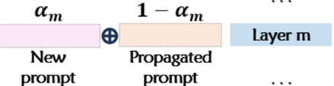
SPT: Prompt hyper-network
Optimal setting of prompt layers under the limited tunable parameter budgets
Assume the parameter budget allows K prompt layers
Prompt hyper-network
To implement the variable importance of different layers
Each intermediate layer with a gated prompt generation layer

Slide 46
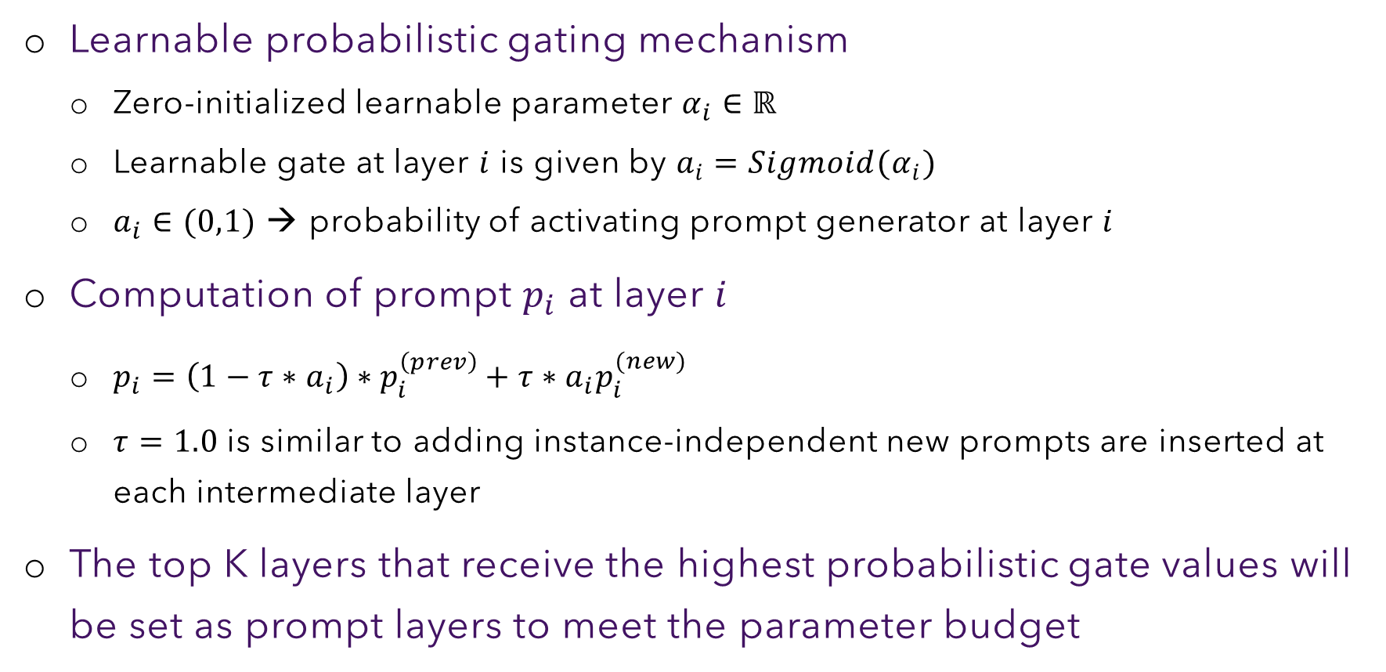
SPT: Prompt hyper-network
Learnable probabilistic gating mechanism
Zero-initialized learnable parameter $α_{i}∈ℝ$
Learnable gate at layer $i$ is given by $a_{i}=Sigmoid(α_{i})$
$a_{i}∈(0,1)$ → probability of activating prompt generator at layer $i$
Computation of prompt $p_{i}$ at layer $i$
$p_{i}=\left(1−τ∗a_{i}\right)∗p_{i}^{\left(prev\right)}+τ∗a_{i}p_{i}^{(new)}$
$τ=1.0$ is similar to adding instance-independent new prompts are inserted at each intermediate layer
The top K layers that receive the highest probabilistic gate values will be set as prompt layers to meet the parameter budget

Slide 47



SPT: Optimization
Two sets of parameters are to be trained:
learnable probabilistic gates ($α_{i}$ or $α$ for simplicity)
prompt generator parameters ($ω_{i}$ or $ω$ for simplicity)
Nested (bi-level) optimization
[Optimize $α$ [Optimize $ω$]]
At each epoch, the train set is split into two splits $𝒟_{α}$and $𝒟_{ω}$
$$\min_{α}{ℒ\left(𝒟_{α}, ω^{∗}, α\right)}$$
$$s.t. ω^{∗}=\underset{ω}{argmin}{ℒ(𝒟_{ω},ω, α)}$$
Outer optimization
$ℒ()$ is the objective function on a given downstream task
Inner optimization

Slide 48

XPrompt
Large performance gap between prompt tuning and fine-tuning for models of moderate and small scales (< 11B parameters)
Trained prompt tokens can have a negative impact on a downstream task and thus degrade its performance.

Slide 49

Impact of Negative Prompt Tokens
How to get rid of the negative prompts?

Slide 50

Lottery Ticket Hypothesis (LTH)
“An over-parameterized network contains a sub-network that, when initialized and trained in isolation, can match or exceed the test accuracy of the original network after training for at most the same number of iterations”
The sub-network is called lottery ticket, and the collection of the tickets is referred to as winning tickets.

Slide 51
LTH in Prompt Tuning
The winning tickets are the collection of positive prompt tokens
can achieve the same performance as using the entire collection of prompts
Losing tickets are the collection of negative prompt tokens
Identify the winning tickets and eliminate the losing ones, in the collection of trained prompt tokens.

Slide 52

Xprompt Workflow

Slide 53

Hierarchical Structured Pruning

Slide 54


Token Level Pruning
Train to identify negative prompt tokens
Associate mask variable $γ_{i}$ to each soft prompt token vector $p_{i}$
$${\hat{P}}_{e}=γ.P_{e} γ=\left\{γ_{1}, γ_{2},…, γ_{m}\right\}, { γ}_{i}∈\{0,1\}$$
Importance score of each token
Expected sensitivity of the model output to the mask variable

Slide 55







Piece-Level Pruning
There are still fine-grained negative prompt pieces remaining in the embedding of each soft prompt token
$$q_{1_{e}}$$
$$q_{e}=\{q_{1_{e}},q_{2_{e}}, …,q_{k_{e}}\}$$
$$q_{2_{e}}$$
$${\hat{q}}_{e}=ζ.q_{e} ζ=\left\{ζ_{1}, ζ_{2}, …, ζ_{k}\right\}, ζ_{i}∈\{0,1\}$$
$$q_{k_{e}}$$

Slide 56
Rewinding Phase
Weight rewinding
Re-train the soft prompts after the two-level hierarchical structured pruning
Reset the parameters of the selected optimal soft prompts
Other soft prompts are pruned by setting the corresponding mask variables to 0
Re-train the soft prompts using the original learning strategies in prompt tuning

